Slide 1

Research & Professional Ethics
CA1 - Modified
Arthur Lubambo
Sep 2023

Slide 2
Proposed Research Title
Fast and Accurate Method to Calculate Melodic Similarity using Probabilistic Data Structures

Slide 3
Introduction of topic
Music information retrieval is an interdisciplinary area between data analytics and music. Music contains multiple elements such as: rhythm, melody, harmony, and others. In the capstone project it will be proposed a method to calculate similarity between melodies, using probabilistic data structures such as HyperLogLog. The Goal is to produce a Fast and Accurate Algorithm for this Problem.

Slide 4
Why
Probabilistic Data Structures is a promising methodology as alternative for traditional computation algorithms that requires a big amount of memory and processing power, with approximations that requires extremely low memory and processing power to be computed. It is being applied in many areas in Big Data such as Natural Language Processing, Genomic, Networking, Realtime Fraud Detection, Games. This project aims to explore this Type of Data Structure used in a Musical Context.
The Artifact will be an implementation of this new method and a comparison analysis with traditional methods in melodic similarity.
It can be used as a Fast, Accurate, and Parallelizable way for Query By Humming or Plagiarism Detection in Melodies.

Slide 5
Objectives
Compare and Contrast Different Similarity Calculation Methods from the Algorithm Complexity Perspective
Compare the accuracy of the new Method Proposed, in relation to traditional State of Art Algorithms
Run experiments to assess how the new method proposed performs in query by humming problem
Implement an Engine to Retrieve the Top Similar Pair of Melodies from a given Dataset, with experimental analysis of Execution Performance (memory usage, execution time)

Slide 6
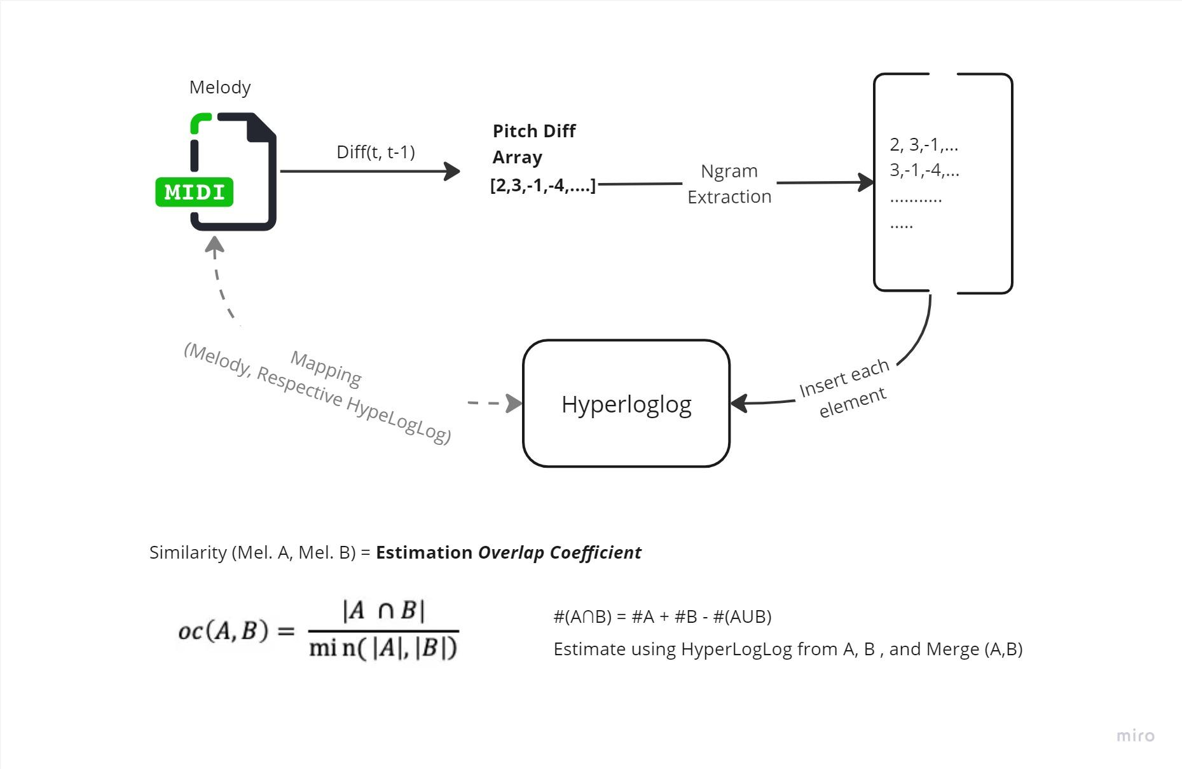
Components

Slide 7
Components of Validity
Accurate: The Research will run experiments comparing the accuracy of the new proposed method with traditional algorithms, and the results will be verified using proper statistical tests.
Relevant: The Problem is relevant, and the new method (using HyperLogLog, or similar) is not well explored in this context.
Reliable: The Research will be based on widely used dataset in area, to benchmark the method consistently
Current: The Musical Context is relatively stable, where the sequence of pitches is the main key characteristic of a melody. The characteristics of data in scope will still be relevant.
Compatible: No Concern about compatibility, the formats in music are very standardized.
Non-Bias: There is a clear level of Bias related to Western Music (twelve pitches, chromatic scale), so Microtonal music or pitch-less songs will not be covered in this research, due to the lack of data, and complexity involved. This BIAS will be tackled delimiting the context where this algorithm can be applied.

Slide 8
Possible Datasets
MIREX (https://www.music-ir.org/mirex/)
Million Song Dataset (http://millionsongdataset.com/)
ORCHSET: a dataset for melody extraction in symphonic music recordings (https://zenodo.org/record/1289786)

